Slide 1
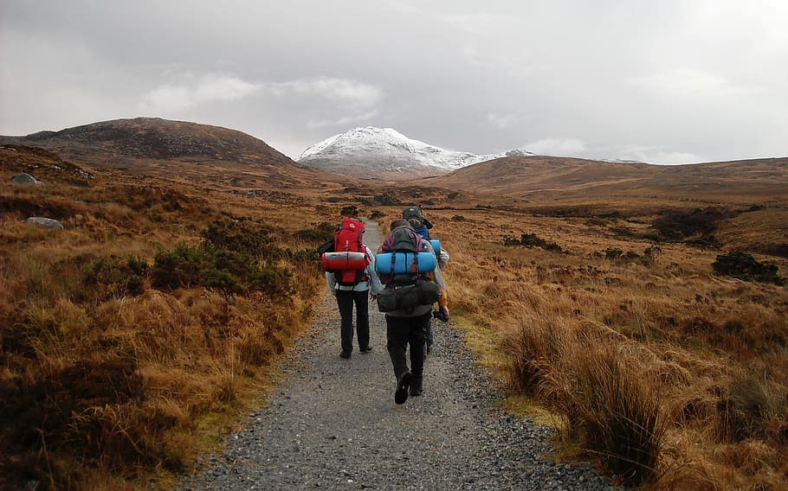
Clan Childlaw’s sibling rights journey..

Slide 2
2015 Individuals working on issue of Sibling Contact and Estrangement start to connect at Clan Childlaw launch event for publication ‘Promoting Sibling Contact for Looked After Children’. 2016 Work intensifies among the future SUFS partners to advance issues. Dr Chris Jones (Strathclyde University) and Dr Gillian Henderson (SCRA) conduct joint research on Supporting Sibling Relationships of Children in Permanent Fostering and Adoptive Families. 2017 Research by Dr Christine Jones (Strathclyde University) and Dr Gillian Henderson (SCRA) on supporting sibling relationships is published in February and SUFS starts to take shape. Chris Jones brings together interested organisations and individuals and in September 2017, partners meet for first time as SUFS. Work begins on SUFS’ website and launch event. Young people begin to record their stories to raise awareness. 2018 SUFS launch
Notes:
Whereas the Children (Scotland) Act 1995 required local authorities to promote contact between children in their care and those with parental responsibilities and rights, there was no mention at all of siblings. There was no obligation to keep siblings together when looked after by the local authority, nor to consider the views of siblings.
There was no obligation on children’s hearings to consider contact with siblings or to give brothers and sisters the chance to be involved in decision-making, despite the fact such procedural rights are protected by article 8 ECHR.
More specifically, a child did not have the right to attend the hearing of their brother or sister, did not have a right to see documents relating to arrangements for contact, and did not have a right to appeal any decision made, even when the decision could restrict their ability to see their brother or sister. This is what happened in ABC’s case.

Slide 3
2019 At a conference on Sibling Contact held by SUFS partners Clan Childlaw and STAR in March, Minister for Children and Young People’s announcement that they will bring forward Bill to change the law. SUFS partners campaign jointly to support and improve the Bill. SUFS contributes to the work of the Independent Care Review on supporting siblings as a key area in the work to overhaul Scotland’s care system.
2020 UK Supreme Court issues its judgement in June in Scottish cases on sibling rights in the Children’s Hearing System, ABC and XY

Slide 4
ABC v Principal Reporter
ABC was aged 14 years. His brother was aged seven years. ABC attended at the children’s hearing of his brother in September 2017 and was asked to leave. The children’s hearing made a condition that regulated the contact between the brothers, without him being present.
Was this a breach of his ‘right to a family life’ under Article 8 of the European Convention of Human Rights? We took it to court to find out, arguing that it was a breach
The case went through every possible level of the legal system in Scotland, and then to the Supreme Court
The judgment was handed down on 18 June 2020. The decision was that there was no breach of article 8. However the Supreme Court recognised that the case had “served to uncover a gap in the children’s hearings system” (para 52).

Slide 5
“Siblings can be as important as parents in the lives of those who have them.
While parents have been likened to the doctors doing their ward rounds to see the bigger picture, siblings have been likened to the nurses: they are there every day. "
(White & Hughes, Why Siblings Matter: The Role of Brother and Sister Relationships in Development and Wellbeing (2018)).
Quoted by UKSC in Paragraph 1 of ABC v Principal Reporter [2020] UKSC 26

Slide 6
2020 SUFS work supporting the new law continues and key improvements are made to the draft law in response to SUFS’ campaign. The Children (Scotland) Act 2020 passes in August. 2021 New Rules of Procedure in Children’s Hearings with new rules for sibling participation approved in February CELCIS develops Practice Guidance to accompany legislative changes to uphold the rights and meet the needs of brothers and sisters with care experience – SUFS contributes its expertise New laws and rules come into force on 26th July 2021 2023 Community of Practice starts to meet
Notes:
Shaping the 2020 Act
Clan Childlaw published a roadmap for changes to the law and advocated these in the public consultation reviewing the 1995 Act. Some were included in the bill published in September 2019. In June 2020 (just after the Supreme Court judgment had been handed down), MSPs supported amendments advocated by Stand Up For Siblings to strengthen provisions for siblings in care.
The minister welcomed the Supreme Court’s decision that there was no breach of article 8 ECHR, but said that the Scottish Government wished to move from “compliance to excellence” in relation to the rights of siblings at children’s hearings. This was the news that many families had been waiting for.
Following further consultation, amendments on participation rights in children’s hearings were included, the Children (Scotland) Act 2020 was passed, regulations and rules of procedure were drafted, and the new provisions came into force on 26 July 20

Slide 7
Duties on Local Authorities – the headlines
1. To make sure that siblings live together if it is safe
2. To promote sibling contact
3. To take the views of siblings into account when making decisions

Slide 8
Children’s Hearing – becoming a participation individual
Children and young people have the right to ask to participate in their siblings’ hearings
The Reporter can decide that the Young Person meets the criteria and invite them
The child or young person can request to become a ‘participation individual’. The Reporter can make a decision about this, or they can arrange a pre-hearing Panel for the Panel to decide whether to grant the status.
A young person very often need advocacy support to access the above, and may require a lawyer

Slide 9
ANYONE CAN SEEK PARTICIPATION INDIVIDUAL STATUS as long as they meet the criteria set out in the legislation:
They are living with, or have lived with their brother or sister
They have an ongoing relationship with their brother or sister
The Children’s Hearing is likely to make a decision which would significantly affect when or how they see or have contact with their brother or sister, or the possibility of having contact with them
They are able to give their views on when or how they see their brother or sister
SCRA website says ‘This is not just about children with the same parents. You may have a brother or sister-type relationship with another child or person that you have lived with. This relationship might be important to you both and these changes respect that. When we talk about brother or sister we are also talking about these important brother or sister-type relationships’ – but currently this is not defined in law.

Slide 10
But note..
SCRA website says ‘This is not just about children with the same parents. You may have a brother or sister-type relationship with another child or person that you have lived with. This relationship might be important to you both and these changes respect that. When we talk about brother or sister we are also talking about these important brother or sister-type relationships’ – but this can sometimes be hard to define or prove.

Slide 11
Siblings Rights outwith Children’s Hearings
Permanence Orders
Adoption Orders
Section 25 (voluntary arrangements)
Not looked after
In any of these situations, there are still steps that can be taken to preserve and maintain sibling relationships.

Slide 12
What does the law say? | Which law says this?
Local authorities must take steps to promote, on a regular basis, personal relations and direct (face-to-face) contact between a child in their care and their siblings, as appear to the authority – having regard to their paramount duty to the child to safeguard and promote their welfare – to be appropriate. | Section 13 of the Children (Scotland) Act 2020, amending section 17(1) of the Children (Scotland) Act 1995
Before local authorities make any decision about a child they are looking after, or are proposing to look, they must get the views of the child’s siblings (where reasonably practicable) and must have regard to those views (as far as practicable). | Section 13 of the 2020 Act, amending section 17(3) of the Children (Scotland) Act 1995
Children’s Hearings and Sheriffs, when they are making, changing or continuing a Compulsory Supervision Order for a child, must consider contact between the child and any siblings and relevant persons they are not living with. | Section 14 of 2020 Act, amending section 29A of the Children’s Hearings (Scotland) Act 2011
The new law applies to both siblings and sibling-like relationships. For the new duties to apply, two people must either: (a) have a parent in common OR (b) have lived together and have an ongoing relationship with the character of a relationship between siblings. | Section 13(2)(b) of the 2020 Act, amending section 17 of the 1995 Act and Section 14(2) of the 2020 Act, amending section 29A of the 2011 Act
The Act also puts beyond doubt that children under 16 can seek and be granted a contact order under section 11 of the 1995 Act without automatically being given parental responsibilities and rights. This is a significant clarification for young people wishing to seek a court order on contact with their siblings | Section 15 of the 2020 Act, amending section 11 of the Children (Scotland) Act 1995 – in force since 17th January 2021
Siblings have the opportunity to participate in their brother or sister’s Children’s Hearings where decisions are being taken that will affect them seeing each other. Children’s Hearings rules have been changed to set out the detail of who can take part and what must happen. Read more here. | Section 25 of the 2020 Act amending the Children’s Hearings (Scotland) Act 2011. and The Children’s Hearings (Scotland) Act 2011 (Rules of Procedure in Children’s Hearings) Amendment Rules 2021.
New duty to place brothers and sister together: Where a local authority is considering placing a child with a kinship carer, with a foster carer, or in a residential establishment, and any sibling of the child is looked after or about to be looked after, the local authority must place the siblings, where appropriate, with the same carer or in the same residential establishment, or in homes which are near to each other if that would better safeguard and promote the welfare of a child than the siblings living together. In either situation, to decide that a placement is appropriate, the local authority has to be satisfied that it safeguards and promotes the welfare of the child which is the paramount consideration. | The Looked After Children (Scotland) Amendment Regulations 2021

Slide 13
Any Questions?
www.clanchildlaw.org
0808 129 0522
helpline@clanchildlaw.org

